Slide 1
Late-Delivery Predictor
NEXTGEN INSTITUTE · MACHINE LEARNING FINAL PROJECT
61%
of late orders caught before they happen
Flagging risky orders at purchase time for an e-commerce marketplace
on 19,294 held-out test orders
Data: Olist Brazilian E-Commerce, Kaggle
Notes:
Hook: a customer orders something and the marketplace already knows the package will probably arrive late. Our model does that at purchase time. It catches 61% of the orders that end up late, measured on orders it never saw. Today: the problem, the data, what we found, how we built it, how well it works, and what we recommend. About ten minutes.

Slide 2
We predict late orders at purchase time
THE PROBLEM
Who has the problem
Decision it supports
An online marketplace with thousands of small sellers. A late parcel means a bad review and a lost customer.
Flag risky orders when they are placed, so operations can warn the customer, chase the carrier or upgrade shipping.
Target
Metric that matters
is_late = 1 when the order arrives after its estimated delivery date. Only delivered orders can be labelled.
Recall on late orders, balanced with precision. Accuracy misleads because only 6.8% of orders are late.
Olist Late-Delivery Predictor
2
Notes:
Who: a marketplace connecting many small sellers with customers. Why they care: late parcels drive bad reviews and lost customers, which we show on a later slide. Decision: at the moment of purchase, flag the risky orders so operations can act early. Target: late means delivered after the estimated date. Metric: we care most about recall on the late class, because missing a late order is the costly mistake, but we watch precision so we do not flood operations with false alarms. Accuracy would be 93% if we predicted on time for everything, so it tells us nothing.

Slide 3
Nine tables become one row per order
THE DATA
96,470
17
6.8%
delivered orders with a known outcome, out of 99,441
features known at purchase: price, freight, weight, route, estimated days, category, payment, timing
of orders are late, a strong class imbalance
No leakage by design
Approval, carrier and delivery dates and review scores are never used as features. The 80/20 train/test split (77,176 and 19,294 orders) happens before anything is fitted.
Source: Olist Brazilian E-Commerce Public Dataset, Kaggle
3
Notes:
We joined orders, items, customers, sellers, products, payments, reviews, geolocation and the category translation table into one row per order. Only delivered orders can be labelled, which leaves 96,470 orders. Seventeen features, all known when the customer buys. Distance between seller and customer comes from the real zip-code coordinates in the geolocation table. The target is imbalanced: 6.8% late. The key design rule is no leakage: anything that happens after the purchase, like approval time, carrier handover, the delivery date itself or the review, is excluded. And we split train and test before fitting anything.

Slide 4
Timing drives lateness
EDA INSIGHT 1
Late rate (%) by purchase month, all years
15.1
WORST SINGLE MONTHS
11.9
12.4
19.0%
of March 2018 orders arrived late
7.5
14.1%
February 2018
5.4
5.0
5.3
4.9
4.4
4.0
3.2
12.4%
November 2017, the Black Friday period
1.8
Jan
Feb
Mar
Apr
May
Jun
Jul
Aug
Sep
Oct
Nov
Dec
Orange bars: months above 10% late. Source: 96,470 delivered orders.
4
Notes:
First big finding: when the order is placed matters more than anything else. Late rate by calendar month swings from 1.8% in June to 15.1% in March. Looking at single months, March 2018 had 19.0% late, February 2018 14.1%, and November 2017, the Black Friday period, 12.4%. Congested periods overwhelm the carriers. This is also why purchase month is the top feature in the model, and why we flag a limitation later: the model learned these specific peaks.

Slide 5
Distance and region matter
EDA INSIGHT 2
Late rate (%) by seller-to-customer distance (km)
LATE RATE BY CUSTOMER STATE
11.8
21.4%
9.9
Alagoas (AL), the worst state
7.0
7.5
17.4%
Maranhão (MA)
4.8
4.5%
São Paulo (SP), the largest customer base
Crossing a state line: 8.0% late, versus 4.5% inside one state.
1–300
300–800
800–1.5k
1.5–2.5k
2.5k+
Orange: above 10% late. States with 200+ orders. Distance from zip-code coordinates.
5
Notes:
Second finding: geography. Using real zip-code coordinates, orders under 300 kilometres are late 4.8% of the time, and the rate climbs to 11.8% for 1,500 to 2,500 kilometres. The very longest bucket is small, 873 orders, so I would not read much into its dip. By state, Alagoas is worst at 21.4%, Maranhão 17.4%, Sergipe 15.2%, against 4.5% in São Paulo. Crossing a state line roughly doubles the risk from 4.5% to 8.0%.

Slide 6
Late deliveries ruin reviews
EDA INSIGHT 3
On-time orders
Late orders
9.2%
62.4%
left a 1–2 star review. Average score 4.29.
left a 1–2 star review. Average score 2.27.
Some sellers stand out: 10 of 621 sellers with 30+ orders were late over 20% of the time, the worst at 34.3%.
A longer promise is no safety margin: late rate by estimated-days quartile is 6.3%, 8.4%, 7.3%, 5.2%.
Reviews are used for analysis only, never as a model feature. 6,381 late and 89,443 on-time reviewed orders.
6
Notes:
This is the business case. Reviews only exist after delivery, so we never use them as a feature, but we can use them to measure the damage. Among on-time orders, 9.2% got a one or two star review. Among late orders, 62.4%. The average score drops from 4.29 to 2.27. Two more findings: a handful of sellers are late over 20% of the time, ten of the 621 with at least 30 orders, worst 34.3%. And a longer promised delivery time is not a simple safety margin: the late rate by quartile of estimated days goes 6.3, 8.4, 7.3, 5.2 percent.

Slide 7
The pipeline keeps the test set untouched
MODELING SETUP
1
Split first
Stratified 80/20 split before anything is fitted, so the test set never influences preprocessing.
2
One scikit-learn Pipeline
Median imputing and scaling for 13 numeric features, most-frequent imputing and one-hot encoding for 4 categorical ones.
3
Tune on training data only
5-fold cross-validation to compare models, then randomized search (12 candidates, 3-fold) scored by PR-AUC.
4
Pick the threshold on training data
The highest-precision cutoff that keeps 60% recall on cross-validated training predictions: 0.39.
5
Score the test set once
19,294 untouched orders give the final numbers.
Olist Late-Delivery Predictor
7
Notes:
This is how we avoided leakage, step by step. One: split first. Two: every transformation lives inside one scikit-learn Pipeline, so imputing, scaling and encoding are learned from training data only. Three: all tuning and cross-validation use the training data only. Four: the decision threshold also comes from training data, the highest-precision cutoff that still keeps 60% recall. Five: the test set is scored once, at the end.

Slide 8
Three algorithms beat the baseline
MODELING
5-fold CV, training data | ROC-AUC | PR-AUC | Recall | Precision
Baseline (majority) | 0.500 | 0.068 | 0.000 | 0.000
Logistic Regression | 0.703 | 0.155 | 0.629 | 0.122
Random Forest | 0.773 | 0.251 | 0.297 | 0.311
Gradient Boosting | 0.779 | 0.250 | 0.662 | 0.169
Tuning
Next problem
Randomized search, 3-fold, scored by PR-AUC: Random Forest 0.252 vs Gradient Boosting 0.248. A near tie, we kept Random Forest.
At the default 0.5 cutoff Random Forest finds only 30% of late orders, so we choose the cutoff deliberately.
Cross-validated on 77,176 training orders. Late = positive class.
8
Notes:
Baseline plus three algorithms: logistic regression, random forest and gradient boosting. All three clearly beat the majority-class baseline, which has no skill at all: ROC-AUC 0.5. Tree models are much better than logistic regression on PR-AUC, 0.25 versus 0.155. Randomized search tuning on the training data only gave a near tie between random forest and gradient boosting, 0.252 versus 0.248, so we took random forest. One thing to notice: at the default 0.5 cutoff random forest has low recall, about 30%. For this business, recall matters, so the next step is picking the cutoff properly.

Slide 9
The final model catches 61% of late orders
RESULTS ON THE UNTOUCHED TEST SET
61%
19.5%
0.79
recall: 800 of 1,307 late orders caught
precision: 1 in 5 alerts is truly late, 2.9 times the base rate
ROC-AUC, with PR-AUC 0.26 against a 0.07 baseline
Test set | ROC-AUC | PR-AUC | Recall | Precision
Baseline (majority) | 0.500 | 0.068 | 0.000 | 0.000
Logistic Regression | 0.710 | 0.158 | 0.628 | 0.122
Gradient Boosting, tuned | 0.793 | 0.255 | 0.662 | 0.174
Random Forest, tuned, cutoff 0.39 (final) | 0.790 | 0.258 | 0.612 | 0.195
Test set: 19,294 orders, 6.8% late. 21.2% of orders flagged high risk.
9
Notes:
These are the final numbers, on 19,294 orders the model never saw. We picked the random forest and set the cutoff at 0.39, chosen on training data to reach about 60% recall. On the test set it catches 61% of late orders, 800 of 1,307. Precision is 19.5%: about one alert in five is truly late, which is 2.9 times the 6.8% base rate. It flags 21% of all orders as high risk. Gradient boosting is close on ROC-AUC. The trade-off is explicit: we accept many false alarms, 3,296, to catch 800 late orders, because a missed late order is the costlier mistake. That only works if the action on a flagged order is cheap, like a proactive message to the customer.

Slide 10
It works best on long routes
ERROR ANALYSIS
Top drivers: purchase month, customer state, estimated days, then distance.
Recall (%) on late orders, by distance (km)
90
80
64
67
Weak spot: São Paulo customers. Recall is 34% where only 4.4% of orders are late.
37
Over time: tested on the newest 20% of orders, ROC-AUC falls to 0.70 and PR-AUC to 0.07.
1–300
300–800
800–1.5k
1.5–2.5k
2.5k+
Orange: weakest group. Test set. The 2.5k+ group has only 171 orders.
10
Notes:
Where does the model fail? It misses 507 of the 1,307 late orders. Recall rises with distance: 37% on routes under 300 kilometres, 64 to 67% in the middle, and 80% on 1,500 to 2,500 kilometres. The 90% for the longest group is only 171 orders, so treat it as indicative. The weak spot is São Paulo customers: recall is 34%, because lateness is rare there, 4.4%. Permutation importance confirms the EDA: purchase month, customer state, estimated delivery days, then distance. One honest caveat: when we train on older orders and test on the newest 20%, performance drops to ROC-AUC 0.70 and PR-AUC 0.07. That period was only 3.5% late, versus 7.6% before, and a lot of what the model learned is tied to specific congested months. So it needs retraining and monitoring. We also tested exact zip-code distance against plain state capitals: no real difference, PR-AUC 0.258 versus 0.260.

Slide 11
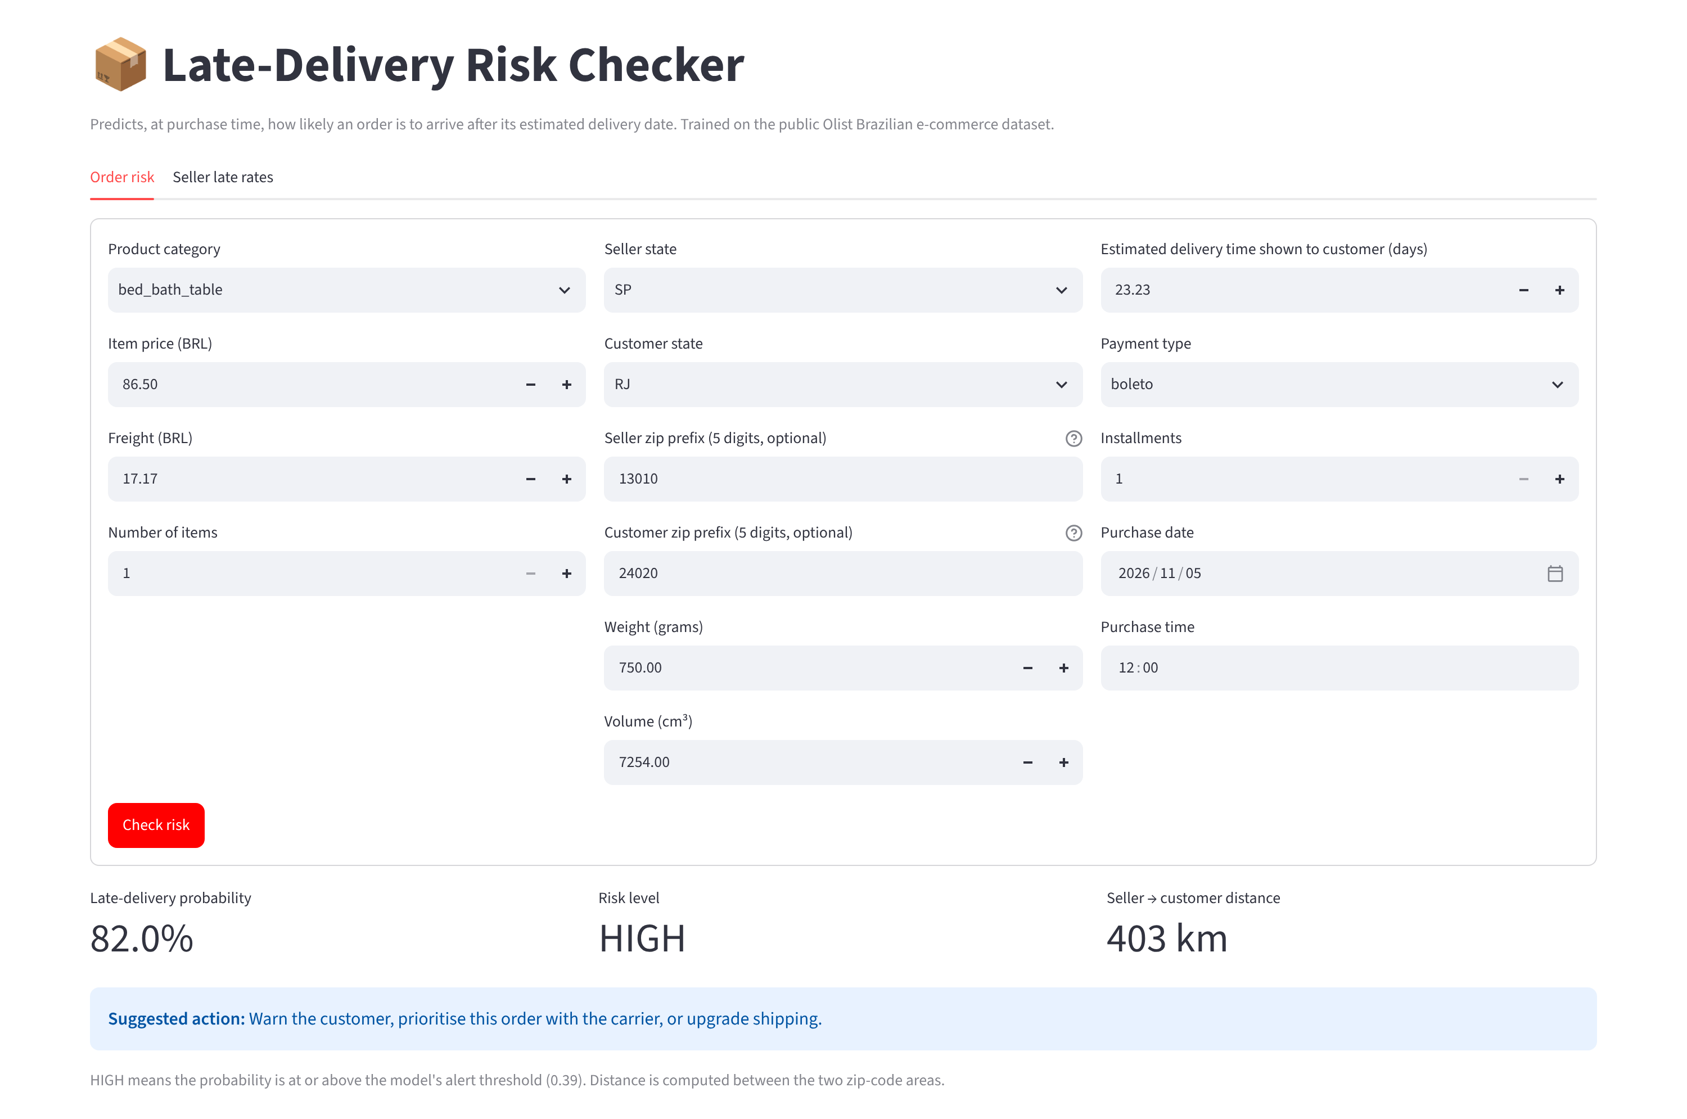
The app gives a risk score per order
THE WEB APP
1. Enter the order. Category, price, freight, route, estimated days and purchase date.
2. Add zip codes (optional) for an exact seller-to-customer distance.
3. Read the result. Late probability, a risk level and a suggested action.
4. Check sellers. A second tab ranks sellers by late rate.
Live app: [app link] · built with Streamlit
11
Notes:
Demo time, about a minute. The app is built for a non-technical user in operations. They enter the order details, optionally the seller and customer zip codes for an exact distance, and press Check risk. They get the late-delivery probability, a risk level, and a suggested action: for HIGH, warn the customer, prioritise the order with the carrier, or upgrade shipping. The second tab ranks sellers by late rate with a minimum-orders filter. In this screenshot, an order from Campinas to Niterói, 403 kilometres, placed in November, comes out HIGH, 82%. Wrong or empty inputs do not crash it: without a valid zip it falls back to the state capital. Note for presenter: replace the app link placeholder after deploying.

Slide 12
Warn early, especially in peak months
RECOMMENDATION
What we recommend
What to watch
Warn the customer and chase the carrier on high-risk orders, above all in Black Friday weeks and in Q1.
Retrain regularly: on the newest orders ROC-AUC falls to 0.70 and PR-AUC to 0.07.
Give longer, honest delivery estimates on long-distance and north-eastern routes, where late rates reach 12–21%.
Only 1 in 5 alerts is truly late, so keep the action cheap, like a proactive message.
Review the 10 sellers that are late over 20% of the time. The app lists them.
Data covers 2016–2018 in Brazil, and distance is a straight line, not the carrier’s route.
Live app: https://late-delivery-prediction-app-aqeqgjexoxgtxyt5ua6p8v.streamlit.app/ ,
Code: https://github.com/omarrebrahim/late-delivery-prediction-app ,
Data: Olist Brazilian E-Commerce, Kaggle
12
Notes:
Recommendation: use the model to act early, not to predict for its own sake. Warn customers and chase carriers on high-risk orders, especially in Black Friday weeks and in the first quarter. Give longer, more honest estimates on long routes and in the north-east, where late rates reach 12 to 21 percent. Review the ten sellers that are late more than 20% of the time. What to watch: the model should be retrained regularly because performance falls on the newest orders; only one alert in five is truly late, so actions must be cheap; and the data is 2016 to 2018 in Brazil, with straight-line distance. Close with the app link and the repo, then questions.

